Slide 1
TA - TEST SUITE
By Chinh Vo

Slide 2
Contents:
Overview
Types of test suite
Create test suite
Test Suite list view
Custom data profile
Execute test suite

Slide 3
OVERVIEW
Test suites are containers for sets of test modules.
Test suites are used to organize and execute test modules based on certain criteria.
Test suites provide flexibility in managing execution plans.

Slide 4
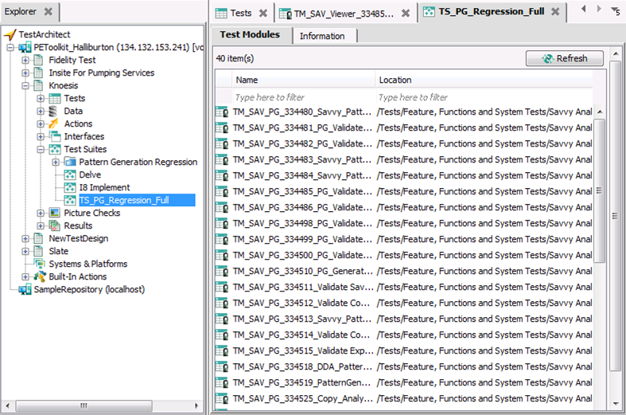
OVERVIEW

Slide 5
TYPES OF TEST SUITE
Static test suite
Static test suites are created manually
Dynamic test suite
Dynamic test suites are generated based on data profiles

Slide 6
TYPES OF TEST SUITE
Note
A static test suite (S) can be changed into a dynamic test suite (D), and vice versa.
(S) -> (D): Change Data Profile
(D) -> (S): Select None Data Profile
Deleting data profile assigned to a test suite makes the test suite turn static.

Slide 7
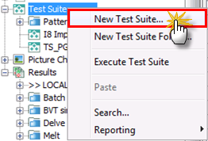
CREATE A STATIC TS
From Test Suite node

Slide 8
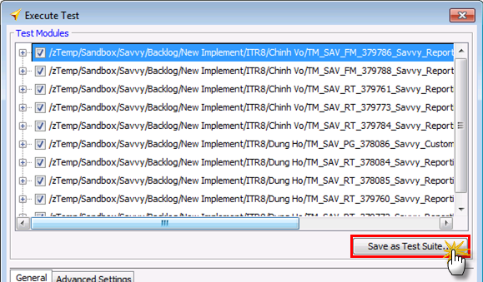
CREATE A STATIC TS
From Execute Test dialog

Slide 9
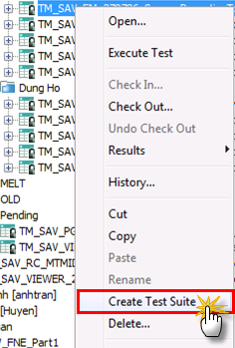
CREATE A STATIC TS
From test module node

Slide 10
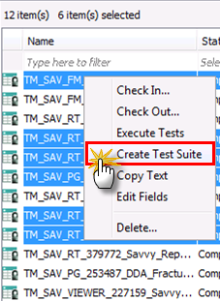
CREATE A STATIC TS
From test module list view

Slide 11
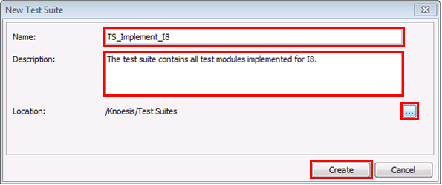
CREATE A STATIC TS
Fill all information for TS, and click ‘Create’ button.

Slide 12
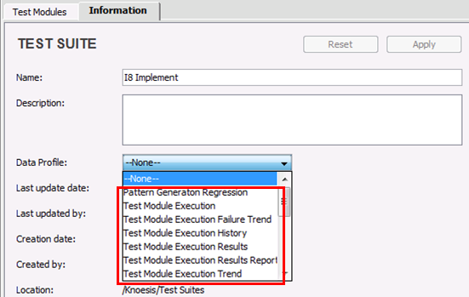
CREATE A DYNAMIC TS
From Static Test Suite

Slide 13
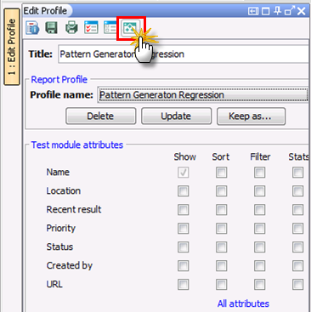
CREATE A DYNAMIC TS
From Reporting

Slide 14
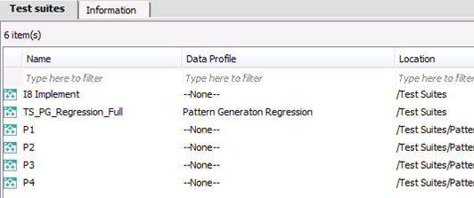
TEST SUITE LIST VIEW
Double clicking Test Suite node opens Test Suite list view.

Slide 15
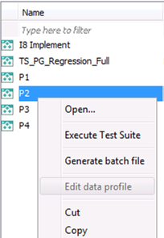
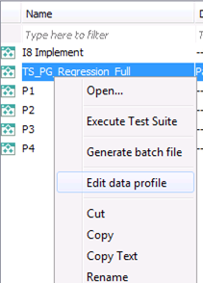
TEST SUITE LIST VIEW
On Test Suite list view, ‘Edit data profile’ is disabled for Static TS.

Slide 16
CUSTOMIZE DATA PROFILE
Field filtering feature of data profile is used to filter which test modules shown in a test suite.
Supported relational operators:
"="; "<>"; "<"; "<="; ">"; ">="; "~"
Values need to be surrounded by double quotation marks (").

Slide 17
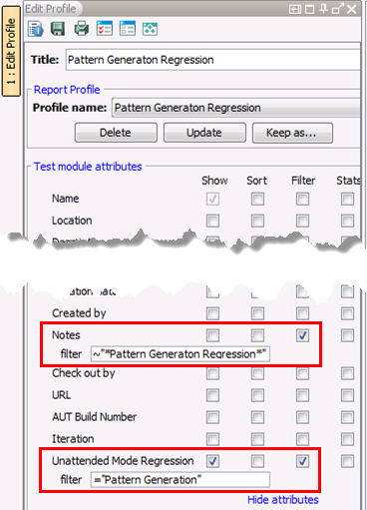
CUSTOMIZE DATA PROFILE

Slide 18
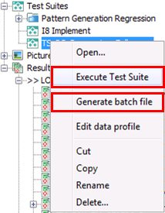
EXECUTE TEST SUITE
A test suite can be executed by:

Slide 19
THANK YOU!

